Slide 1

Digital Logic Design

Slide 2
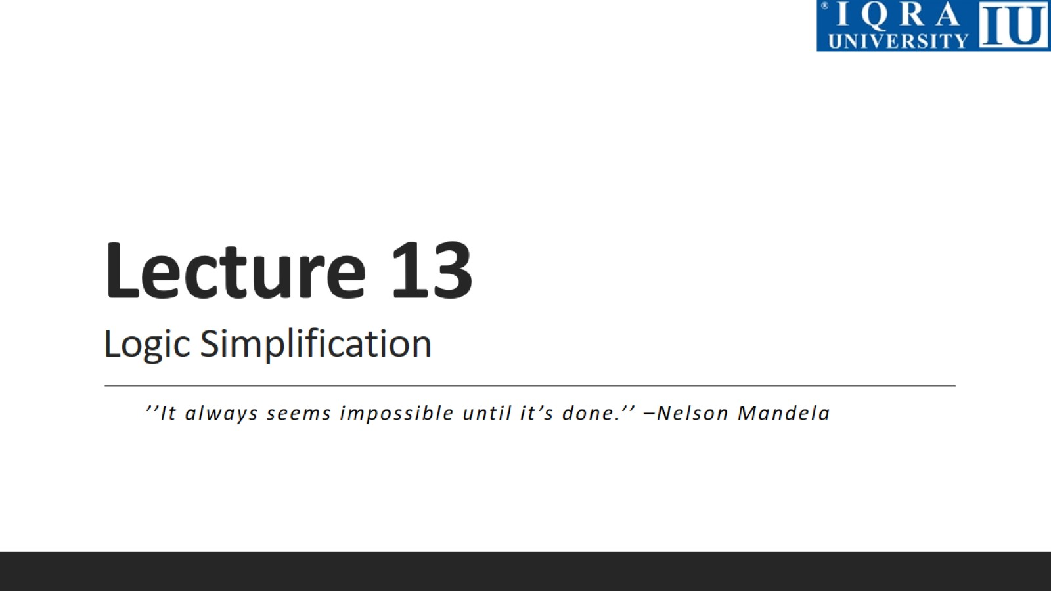
Lecture 13 Logic Simplification

Slide 3
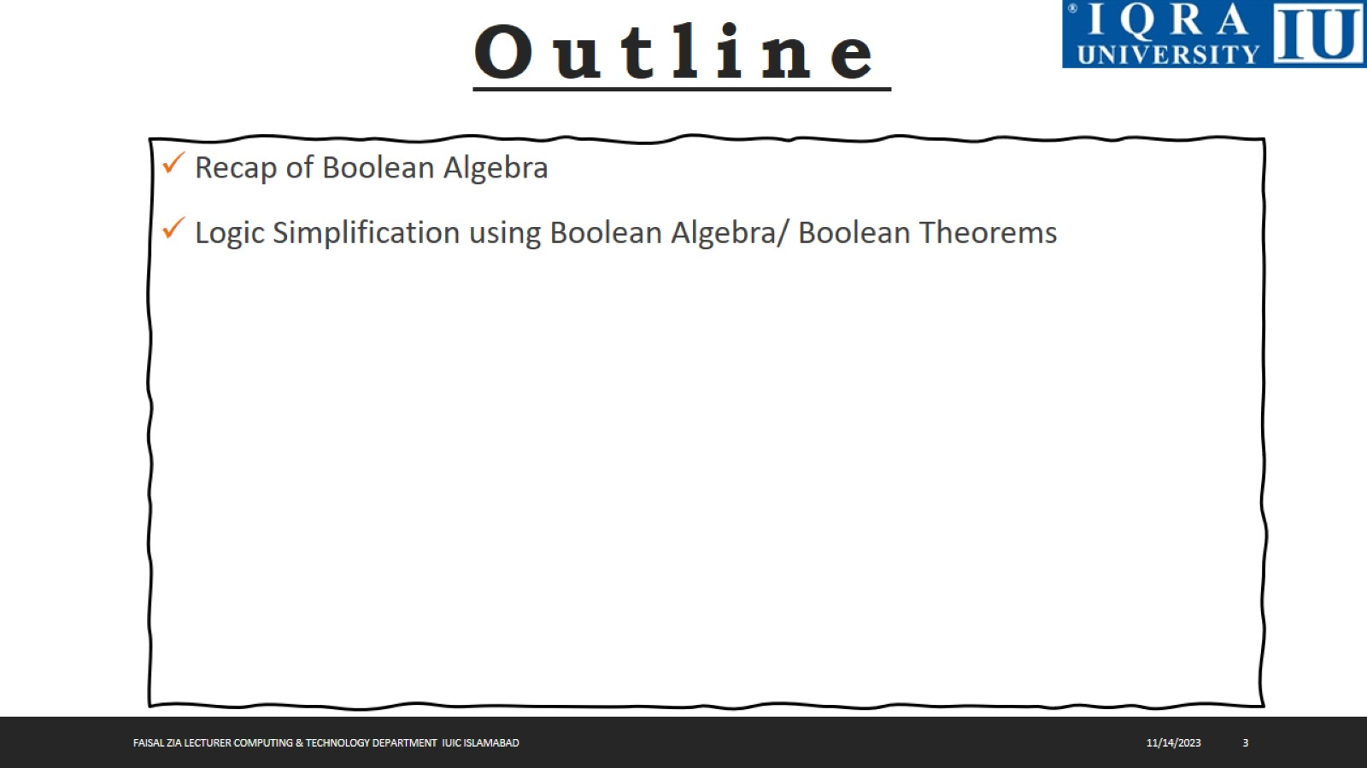

Slide 4
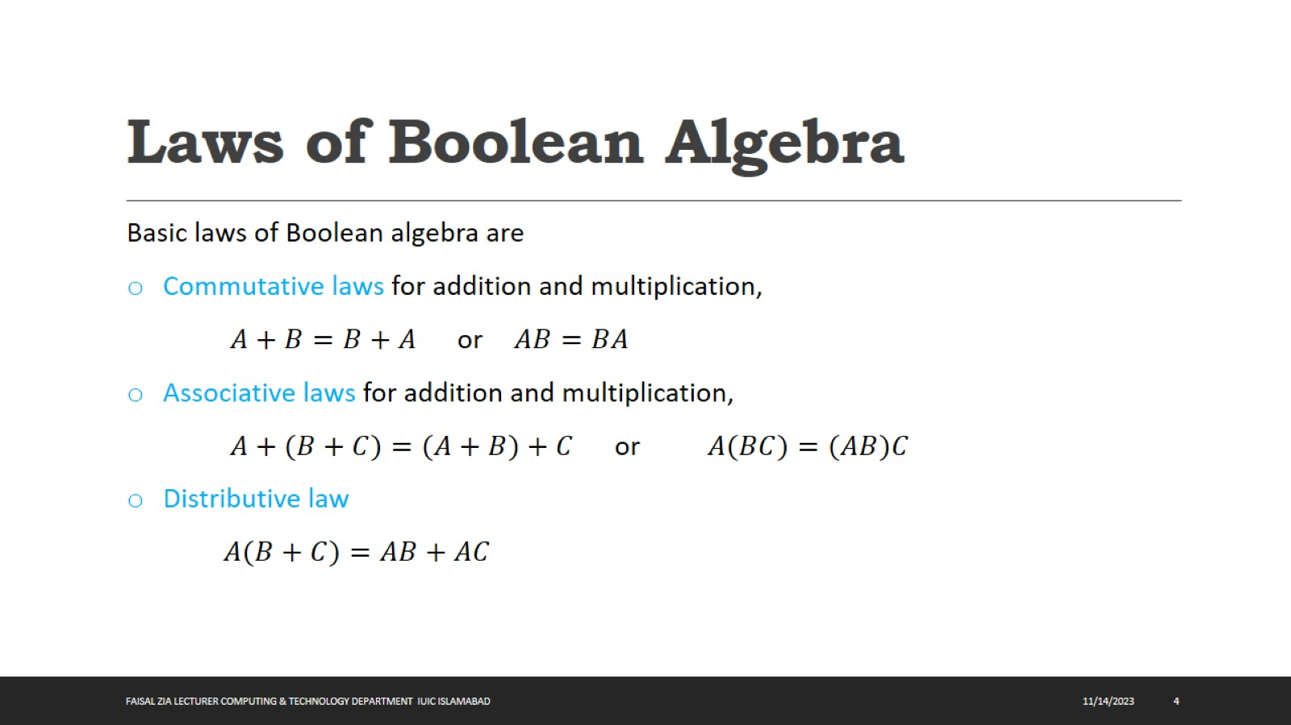
Laws of Boolean Algebra

Slide 5
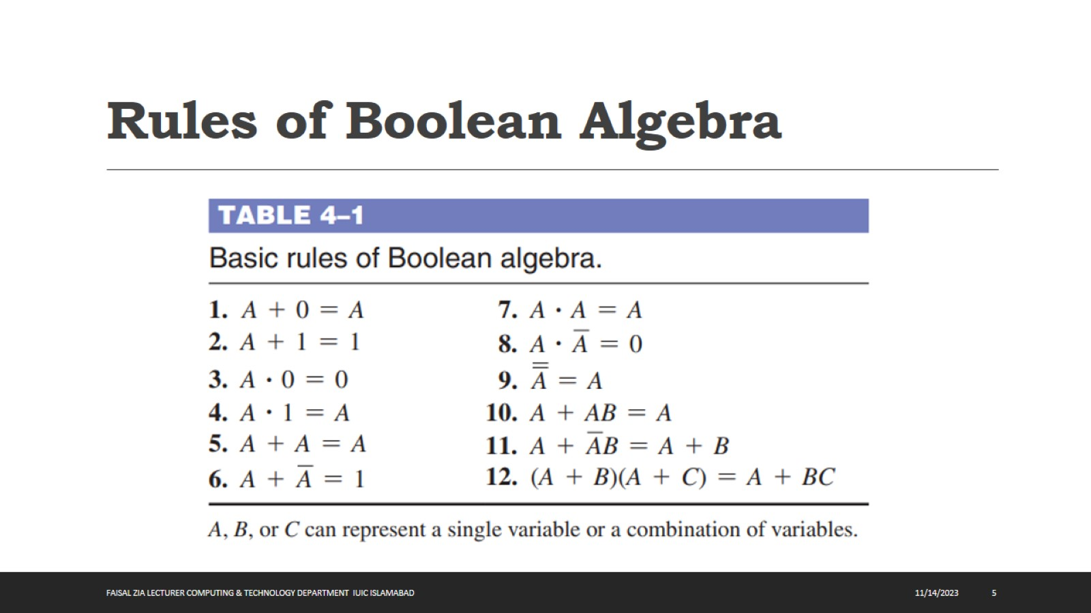
Rules of Boolean Algebra

Slide 6
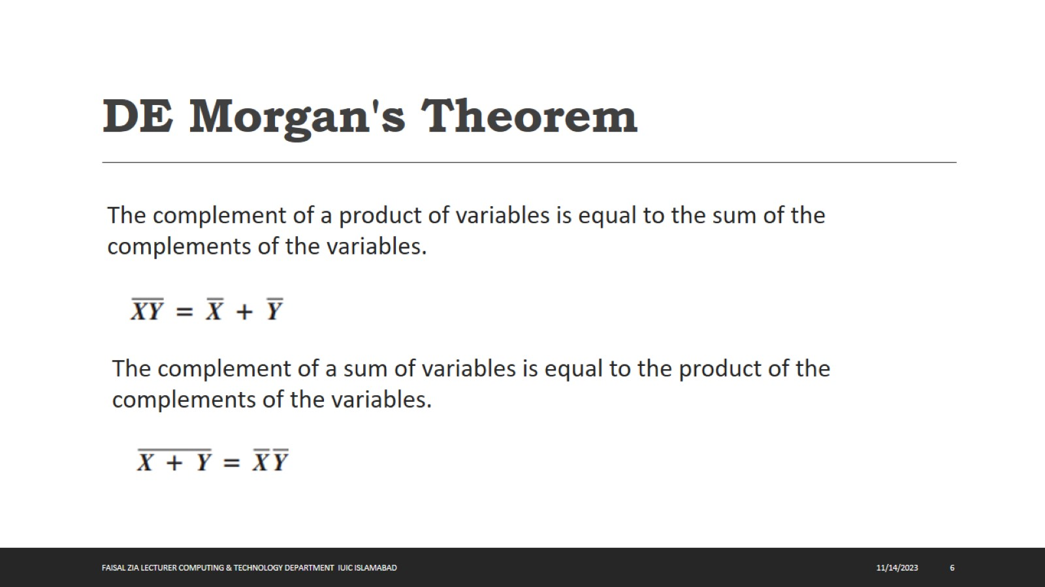
DE Morgan's Theorem

Slide 7
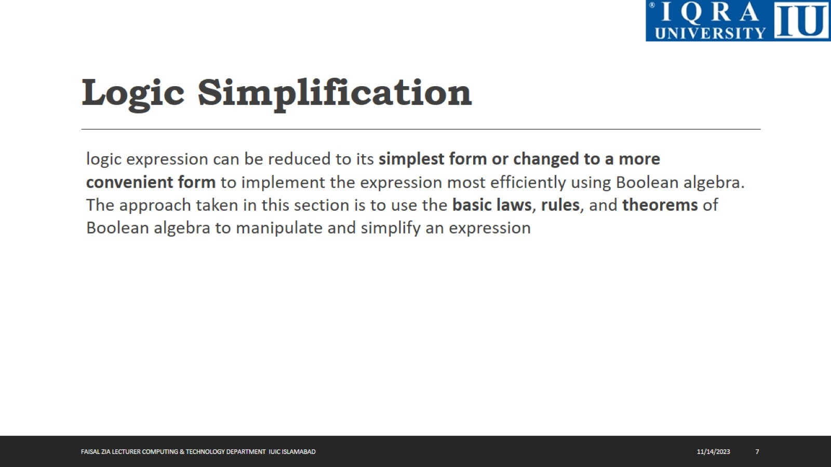
Logic Simplification

Slide 8
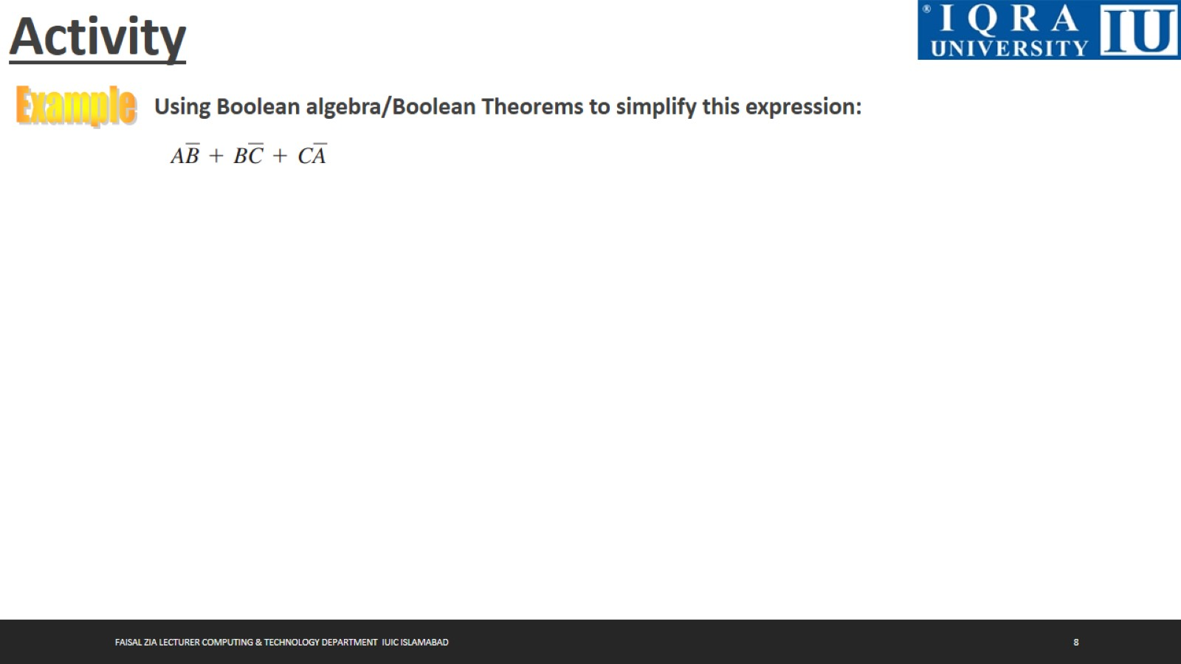
Activity

Slide 9

Activity

Slide 10

Activity

Slide 11
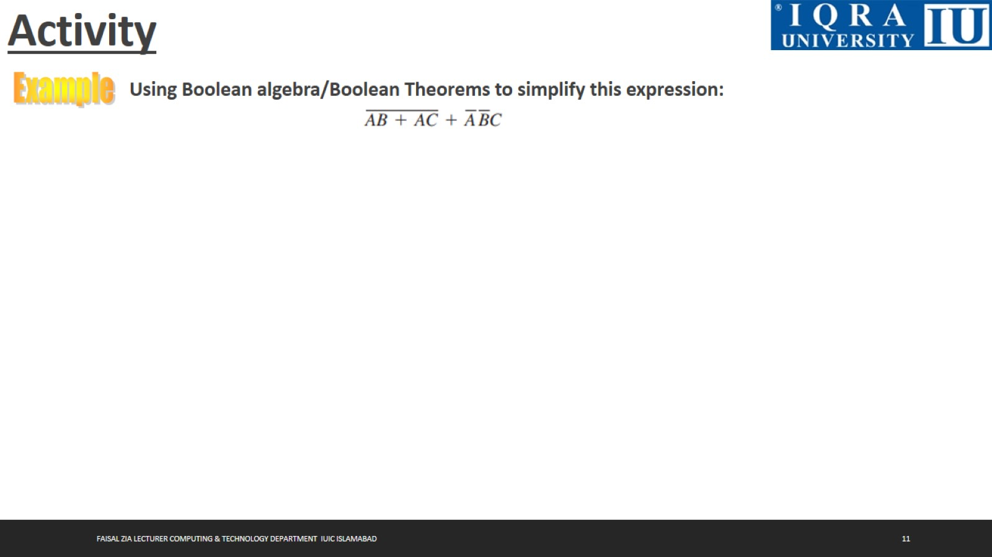
Activity

Slide 12

Activity

Slide 13
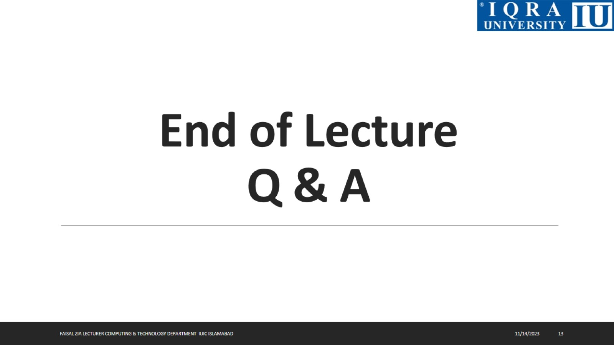
End of Lecture Q & A

